Slide 1
EGR-314 Team 6
Dylan Turner, Jedriq Ventura, Nathan Hoge, Samuel Striffler

Slide 2
Team Charter
Produce systems that can respond to the environment using serial sensing and actuation.
Being able to produce a network of digital sensors and being able to apply that data.
Being able to make a complex system in a mobile/carry-on fashion
A system of subsystems that will actually integrate with one another, and allow for communication between the systems.
We will work on a system of productivity to ensure deadlines are met.
We will have an interdependency system between team members for each system. This will entail a main and secondary person on each subsystem.

Slide 3
Mission Statement
Our team is tasked with making a mobile weather station, with applications of at least two sensors, switching regulator, and motor articulation dependent on sensor input. Success in this project will rely on our understanding of our device, and its several parts even though it’s assigned to one member, each member should have some hand in helping between integration and overall device readiness of its subsystems. Success will be measured through creation of a robust, high quality device with straightforward and convenient operation for the end user.

Slide 4
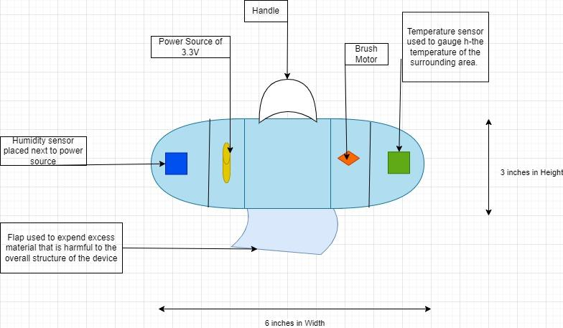
Design Concept 1
This is our 1st concept of the Mobile Weather station. This is our bare bones of what we want in terms of mobility and design. This would be a simple pill device that would house the necessary parts that would be included in the device. Such as the brush motors, and a 3.3V power supply. The overall design was open ended, but my main inspiration for this was certain weather probes that have a very cylindrical or pill shape which allows for minimal wind resistance and overall protection of the device if it ever encountered outside damage.

Slide 5
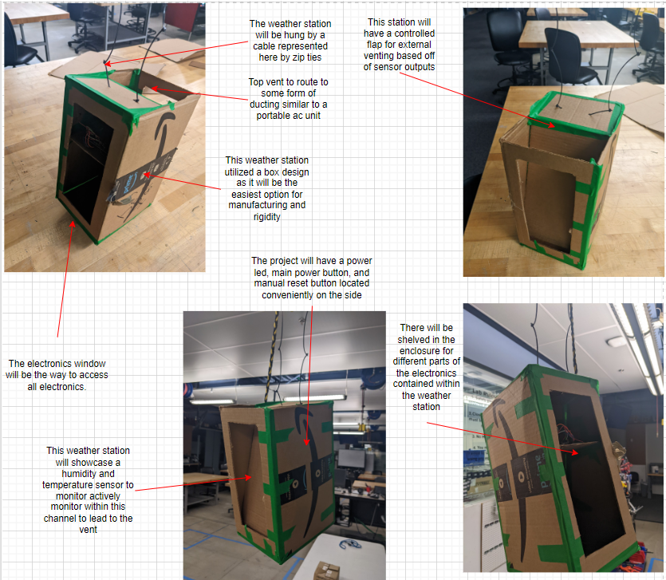
Design Concept 2
In our second concept design, we propose utilizing a box shaped hanging weather station. This will utilize a rechargeable and replaceable 3.6v battery platform for power. It will monitor temperature and humidity actively, and vent to the atmosphere to regulate internal temperature and humidity for our end user based upon their settings. It will showcase a welded steel frame that will be line-x coated for superior durability. It will have a lexan window encasing the electronics that will be removable to change batteries, and access all electronic components for any necessary maintenance. On the weather station, simple controls for operation will be located such as power, reset, and accompanying them will be a status led for the weather station depending on which mode it is in (open or closed). It will have the ability to be hung by incorporating a braided steel cable from the top. It uses an internal duct to house the sensors that are actively monitoring their respective data. At the top of this duct will be a door that opens controlled by a simple 3.6v brushless motor. This door will allow the vent to go into a form of ducting that will connect the weather station to the atmosphere. This ducting will be completely removable and work in conjunction with the weather station.

Slide 6
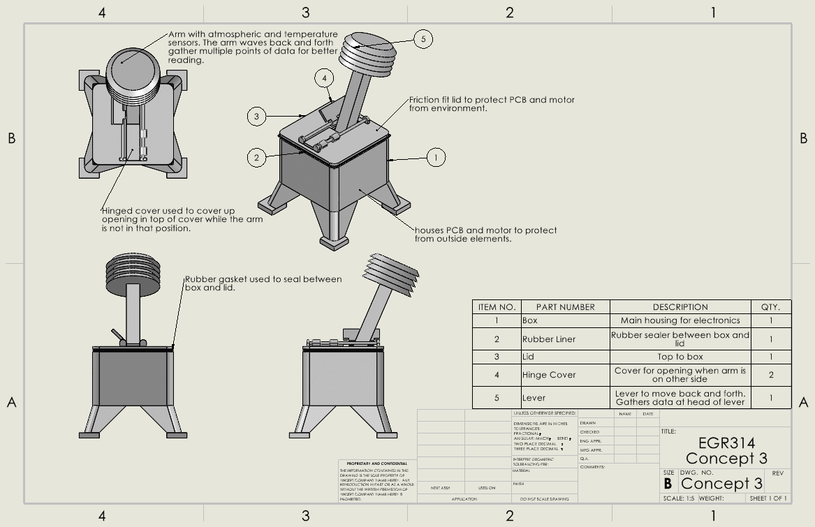
Design Concept 3
This design was based on the idea of a “thermometer” on a stick. Using the arm pictured above the device would send a signal out to the motor which would swing the arm back and forth. This would be the starting point for our readings, and when the arm stops will be the ending of our readings. The box would be the main housing for the electronics. (This will store the Battery, Regulators, and Motor.) Our sensors are located on the end of the arm. This idea is meant to be placed down like in a garden or greenhouse, and you could get readings at any point from something like your phone. You would be able to send a signal from an app or something which would tell the motor to do a swing and take a measure. The measurements given back to you would give you temperature and humidity readings.

Slide 7
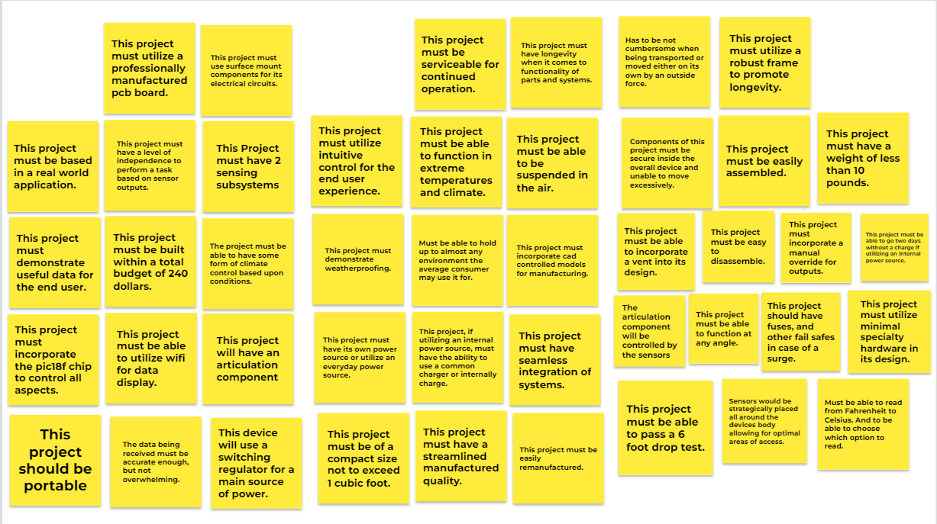
User Needs

Slide 8
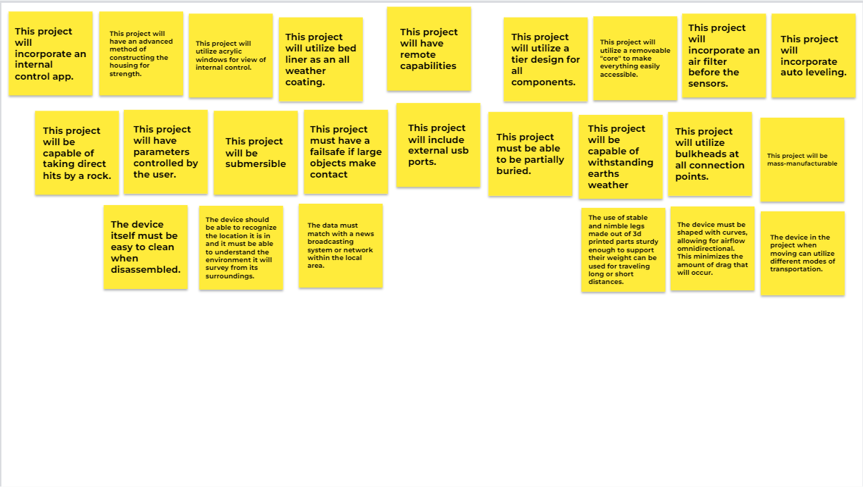
User Needs
Stakeholders:
Target Group
Home botany enthusiasts
Small batch farmers
Terrarium enthusiast
Biology teachers
Reptile owners/Zoos
External Partners
Arizona State University
Professor Travis Kelley
EGR314 Teaching Team
JL PCB
Mouser
Digikey

Slide 9
Product Requirements
Hardware
This project must utilize a professionally manufactured pcb board. (E)
This project must use surface mount components for its electrical circuits.(E)
This project must incorporate the pic18f chip to control all aspects.(E)
This device will use a switching regulator for a main source of power.(E)
This project must have its own power source or utilize an everyday power source. (L)
This project must be able to go two days without a charge if utilizing an internal power source. (L)
This project, if utilizing an internal power source, must have the ability to use a common charger or internally charge. (L)
This project should have fuses, and other fail safes in case of a surge. (L)
This project must utilize minimal specialty hardware in its design. (L)
This project will include external usb ports.(E)
Software
This project will have seamless integration. (L)
This project will have an automatic override (If this… then restart) (L)
This project will have data collected and used.(E)
This project will include auto leveling.(E)
This project will be able to switch units of measurement (metric to imperial, celsius to fahrenheit) (E)
This project will have reactions to different environments. (L)
This project will have parameters set by the user.(E)
This project will have a control app.(E)

Slide 10
Product Requirements
Manufacturing
This project must be built within a total budget of 240 dollars.(E)
This project should be portable.(E)
This project will have an articulation component.
This project must be serviceable for continued operation.(E)
This project must have longevity when it comes to functionality of parts and systems. (L)
This project must demonstrate weatherproofing.(E)
Must be able to hold up to almost any environment the average consumer may use it for. (L)
This project must incorporate cad controlled models for manufacturing. (E)
This project must be of a compact size not to exceed 1 cubic foot. (L)
This project must have a streamlined manufactured quality. (L)
Safety
The device should be padded and have no sharpness to ensure minimal injury.(E)
The device should be made in a way to ensure that the user is nor harmed when handling the device. (L)
This project must have a failsafe if large objects make contact.(E)
This project will not blow up.(E)
This project must be able to be partially buried.(E)
Interactivity
This project will have parameters set by the user.(E)
This project should be portable. (E)
This project needs to be able to be in different climates. (L)
This project will have an app for the user.(E)
This project will display all sensor data.(E)
The motor, sensors and power supply will all run in unison. (L)
Customization
This project will be submerged.(E)
This project will be able to be buried.(E)
This project will be able to be suspended.(E)
This project will be able to slip out of its cover to another one.(E)
This project will include external usb ports.(E)
This project will have a variety of uses. (L)

Slide 11
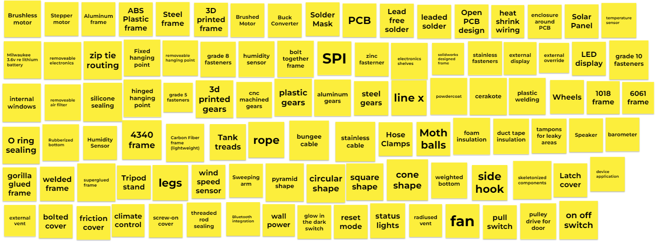
Design Ideation

Slide 12
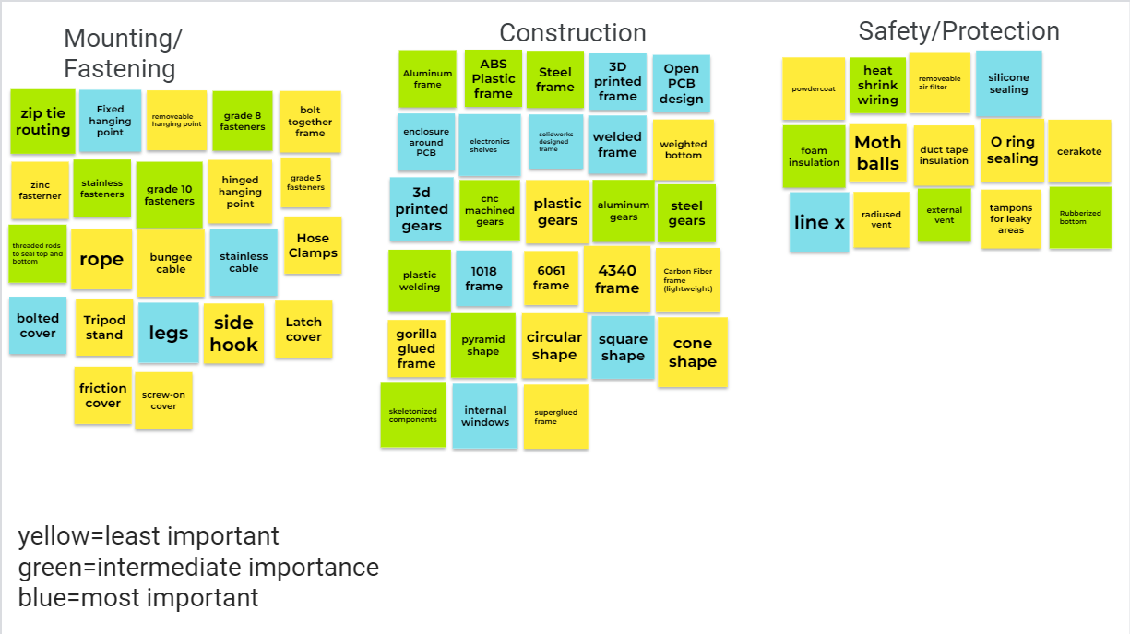
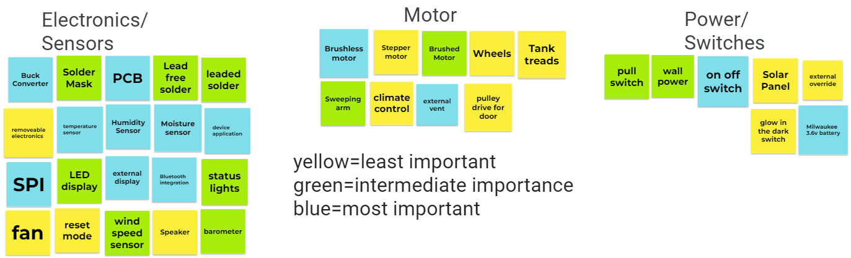
Design Ideation

